Slide 1
Profiles
WAS App Server Profile
WAS Core binaries files
WAS management Profile

Slide 2
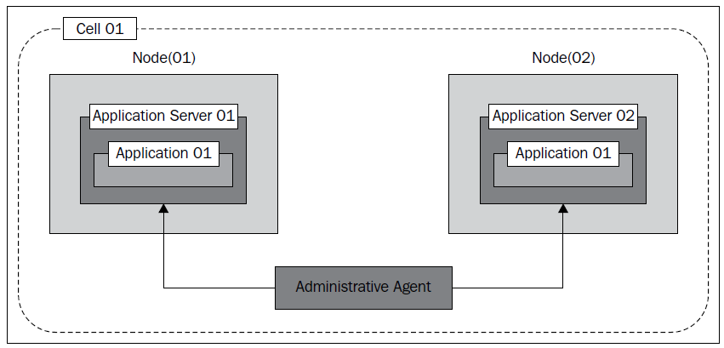

Slide 3
WAS installation will have set of Profiles.
A Profile will have set of Cell.
(Cell is logical group name for set of Nodes)
A Cell will have set of Node
a Node will have ONE Server

